Slide 1




Hack With Her 4.0 by edifecs
SheCura
ONE STOP SOLUTION FOR ALL WOMEN RELATED HEALTH TECH CARE.
PRESENTED BY :
KHUSHBOO JAIN
ADITI AGGARWAL
ISHLEEN KAUR

Slide 2


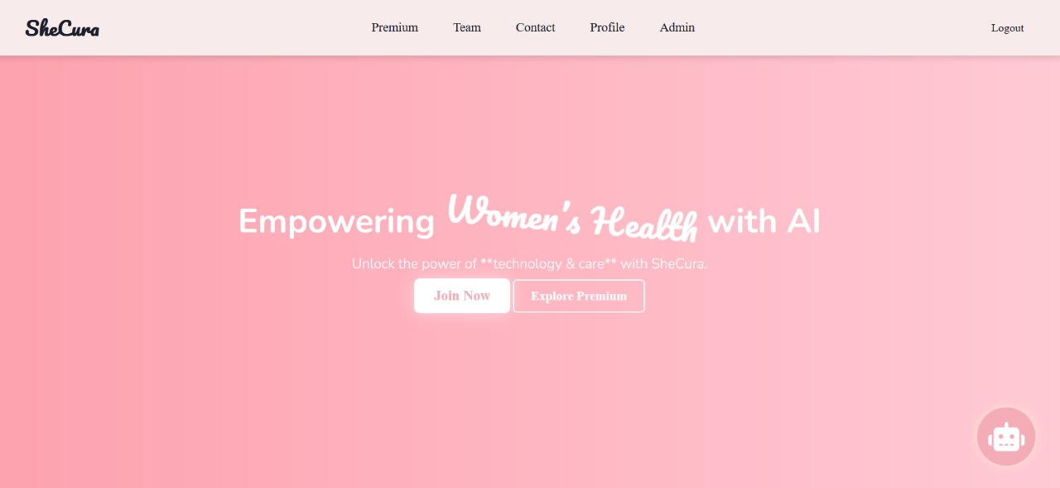
LANDING PAGE
Empower Women’s Health with AI. SheCura is a comprehensive health tech platform designed to empower women with personalized healthcare solutions.A user-friendly and interactive experience, SheCura is built to support and enhance women's health journeys.

Slide 3
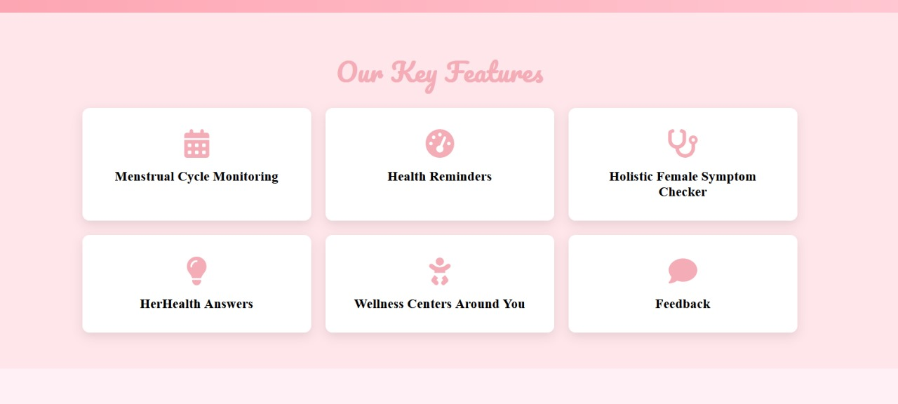
OUR KEY FEATURES
Women’s comfort are our top priorities. We provide a one stop solution for our users having features like Menstrual Cycle Monitoring , Health Reminders , Holistic Female Symptom Checker , Wellness centers around you which will display you all the current time centers in the particular state you enter ,Feedback option too where users can provide us feedback which will be helpful to improve further .

Slide 4

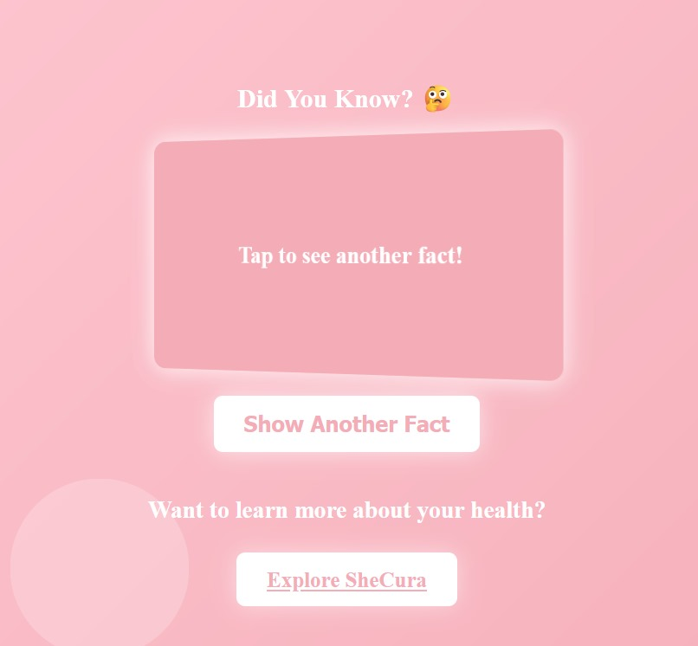
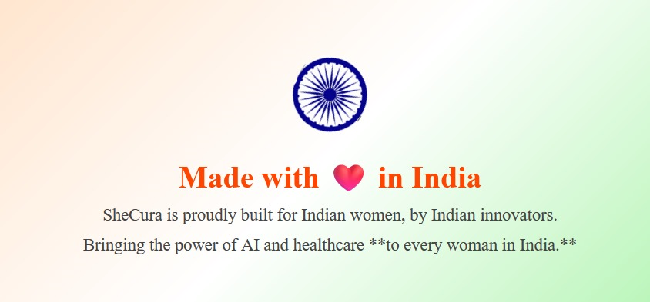

EYE CATCHING SECTION
We are also having a fact section where we can see different types of facts.
Our website is developed in India .

Slide 5


PREMIUM SECTION
Premium Section:
AI-Powered Chatbot – Get instant health advice and support.
EmpowerFit – Tailored fitness plans for women's well-being.
NourishWell – Personalized nutrition and diet recommendations.
AuraPlay – Mindfulness and guided meditation sessions.
ZenMode – Stress management and relaxation techniques.
MyHealthInsights – Data-driven health insights and trends.
A user-friendly and interactive experience, SheCura is built to support and enhance women's health journey

